Slide 1
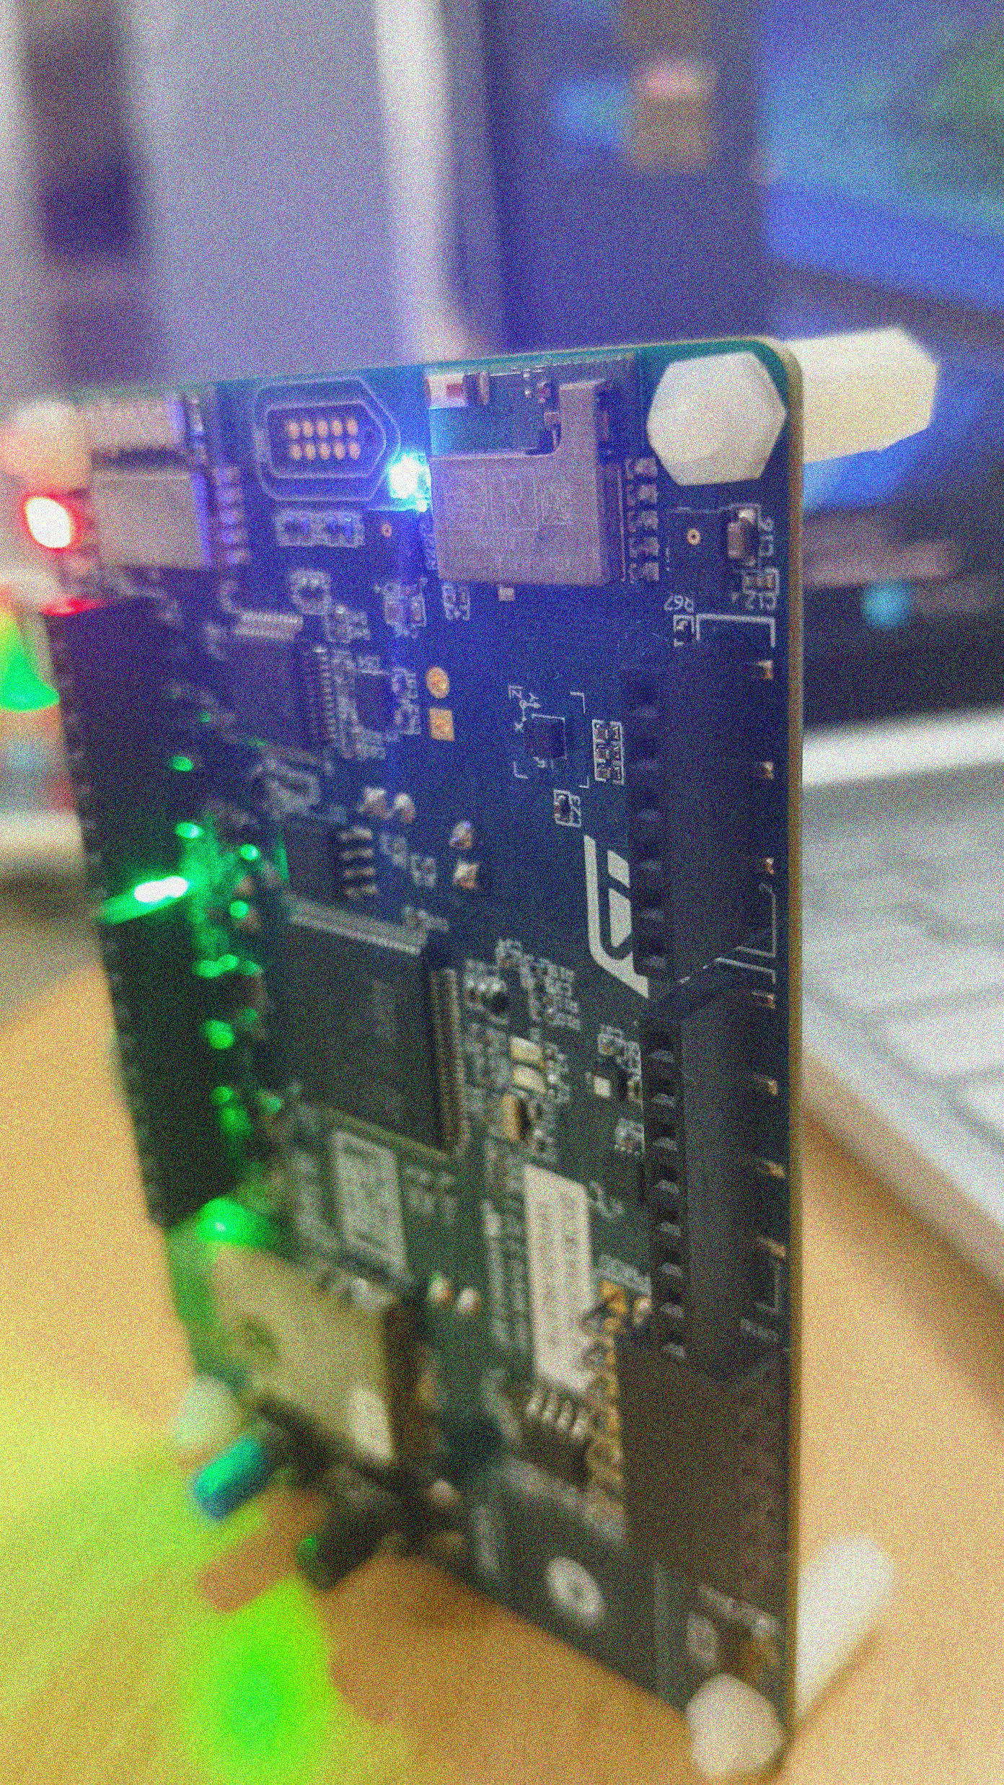


Real-Time Anomaly Detection in Temperature Sensors Using STM32 and Nano Edge AI

Slide 2

Problem Statement
Temperature sensors are critical components in various industries, but their malfunctions can lead to significant losses. Traditional cloud-based anomaly detection systems suffer from latency and dependency. This project aims to develop a standalone, real-time anomaly detection system using STM32BL475EIoT1A and Nano Edge AI for efficient and accurate temperature sensor monitoring.

Slide 3
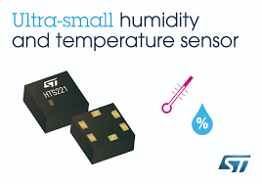
Introduction
HTS221 Sensor Overview:
On board Senso ultra-compact digital sensor for temperature and humidity.
Low power (2 μA @ 1 Hz ODR) with selectable ODR (1 Hz to 12.5 Hz).
Humidity range: 0 to 100% rH; Temp accuracy: ±0.5 °C (15°C to 40°C).
Embedded 16-bit ADC, I2C/SPI interfaces, factory calibrated.
Tiny package (2 x 2 x 0.9 mm), operates from -40 °C to +120 °C.
Application in Anomaly Detection:
Ideal for environmental monitoring and HVAC systems.
Real-time anomaly detection with NanoEdge AI and STM32.
Edge AI improves response time and bandwidth efficiency.

Slide 4
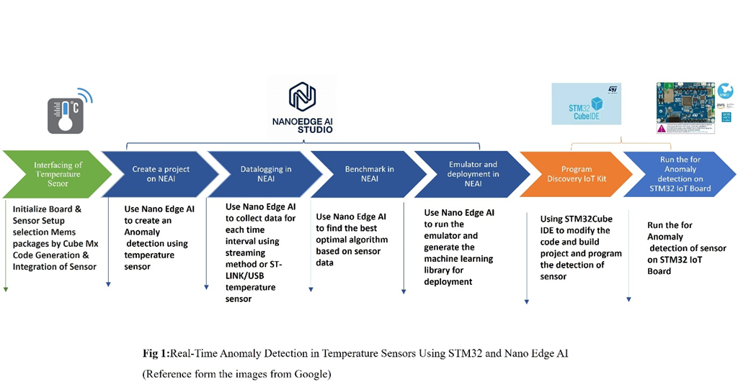

Implementation and Methodology
Step by Step Implementation of Project
Create a Project on STM32 Cube IDE
Interfacing Temperature sensor(HTS221)
Create a Project on NEAI
Datalogging in NEAI
Benchmark in NEAI
Emulator and Deployment in NEAI
Program on Discover Board(BL4-IOT1A)
Run Anomaly Detection Board

Slide 5
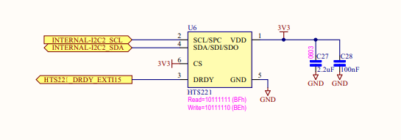
Block Diagram Interfacing Temperature sensor(HTS221)
Pin Connections:
INTERNAL_I2C2_SCL-PB10
INTERNAL-I2C2_SDA-PB11
VDD - 3.3 V
VSS -GND
HTS221_DRDY_EXTI15-PD15
CS-PA2

Slide 6
Flowchart For Anomaly Detection
Start
Initialize the System peripherals
Initialize Temperature Sensor(HTS221)
Initialize NanoEdge AI Library
Learning Phase
While loop starts
Get New Temperature Data (fill_buffer())
Detect Anomalies
No
Yes
Similarity >= 70%
print "Anomaly Detected“
print "Normal Behaviour“
Delay
End

Slide 7
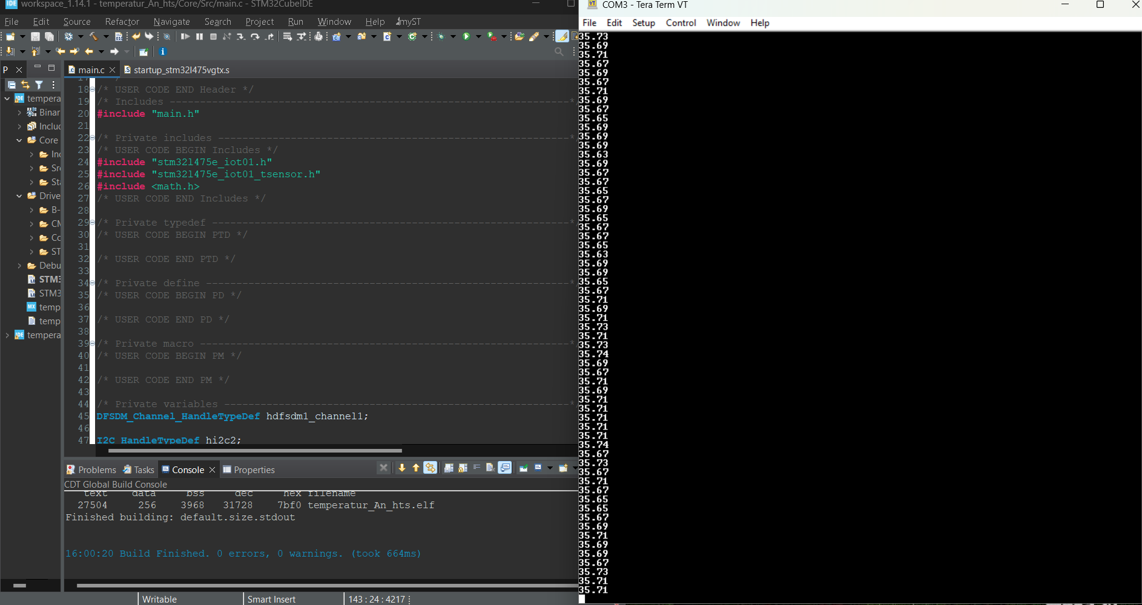
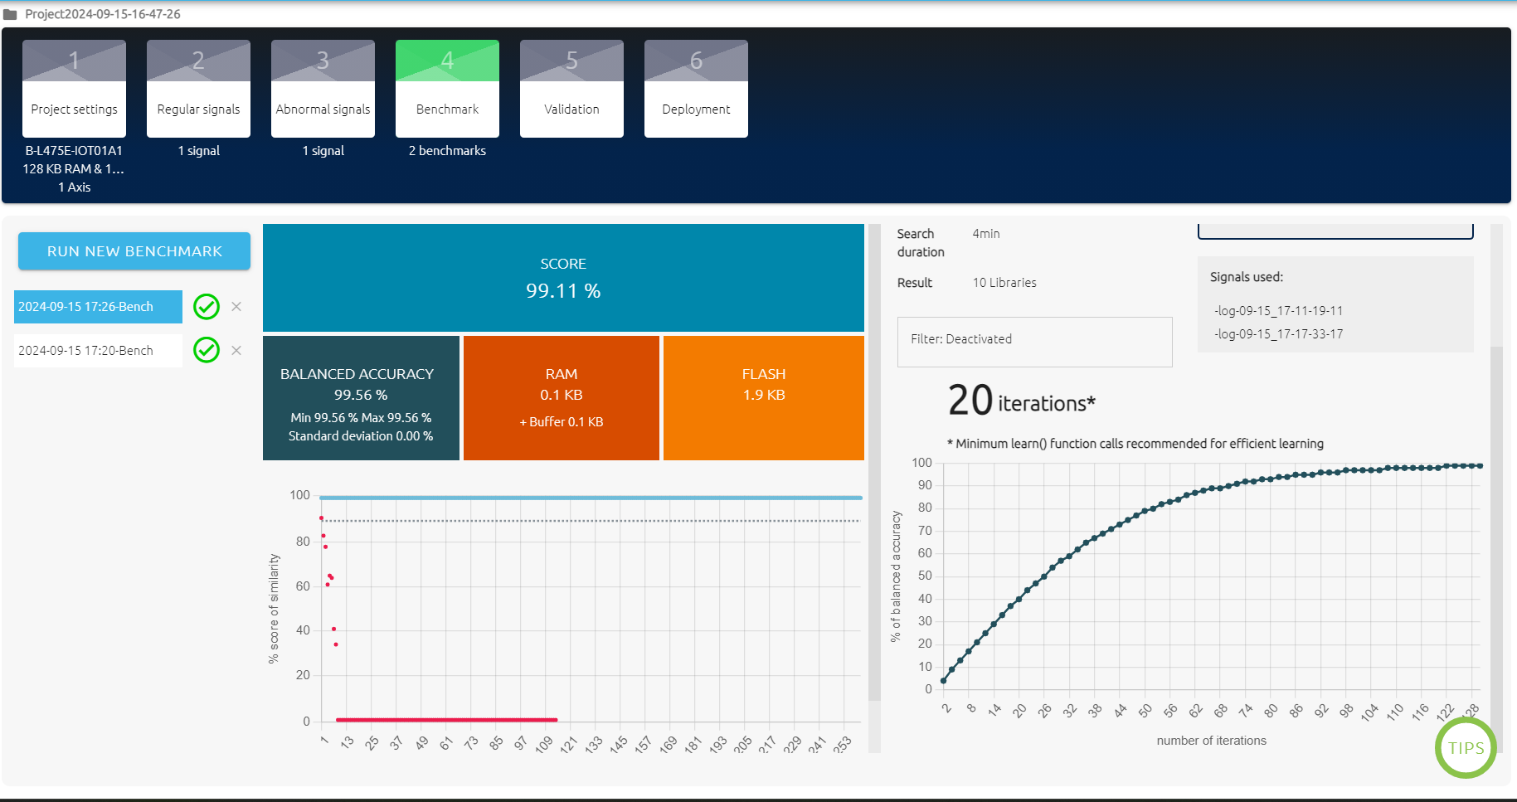
Results
Temperature sensor values
On Benchmark

Slide 8
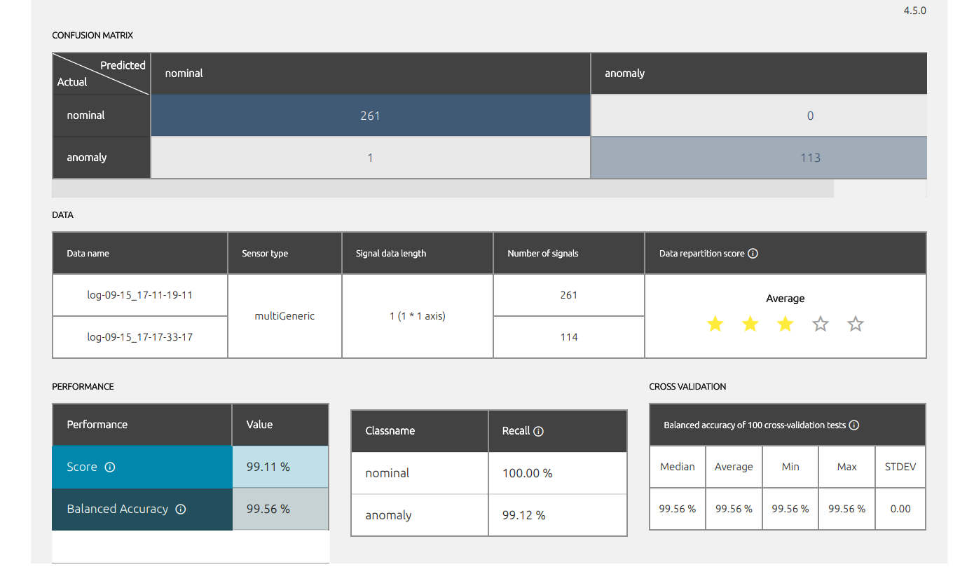
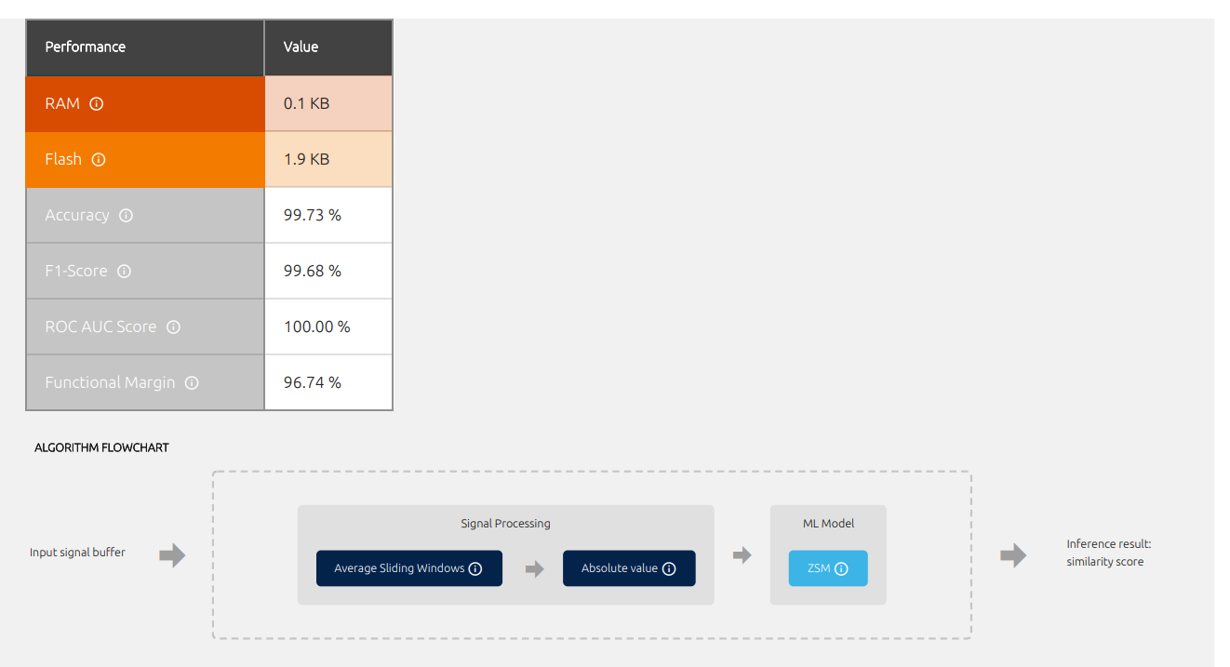
Validation Metrics of Model In NEAI

Slide 9
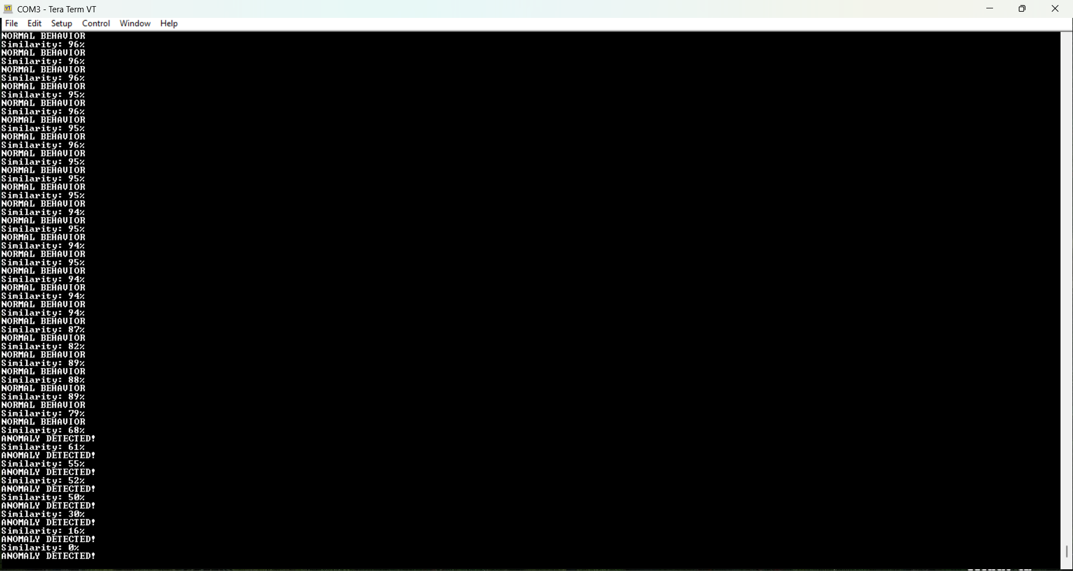
Anomaly Detection

Slide 10
Conclusion
Our project on anomaly detection in temperature sensors utilizing NanoEdge AI and Cube IDE demonstrates a powerful approach to enhancing sensor reliability and performance. By integrating advanced AI techniques with efficient development environments, we have developed a robust system capable of identifying deviations in temperature readings with high accuracy. This solution not only improves operational efficiency but also significantly reduces the risk of equipment failure and operational downtime. Moving forward, further refinements and real-world testing will be essential to maximize its potential and ensure it meets the highest standards of performance.

Slide 11
References
STMicroelectronics,”B-L475E-IOT01A-STM32 Discovery Kits-STMicroelectronics,” Discovery kit for IoT node, multi-channel communication with STM32L4 - User manual Accessed: October 2023.
STMicroelectronics, "STM32CubeIDE User Guide," https://www.st.com/resource/en/user_manual/um2609-stm32cubeide-user-guide-stmicroelectronics.pdf, Accessed: September 2023.
STMicroelectronics, "NanoEdge AI Studio," https://wiki.st.com/stm32mcu/wiki/AI:NanoEdge_AI_Studio, Accessed: January 2024.
STMicroelectronics, "ST Edge AI Suite," https://www.st.com/content/st_com/en/st-edge-ai-suite.html, Accessed: February 2024.
STMicroelectronics, "How to Use NanoEdge AI Studio for Anomaly Detection," https://community.st.com/t5/stm32-mcus/how-to-use-nanoedge-ai-studio-for-anomaly-detection/ta-p/697858, Accessed: September 2024.
STMicroelectronics, "HTS221: Capacitive Digital Sensor for Relative Humidity and Temperature," https://www.st.com/en/mems-and-sensors/hts221.html, Accessed: December 2024.

